Slide 1

BugBase 1.0
Say Hello to…

Slide 2
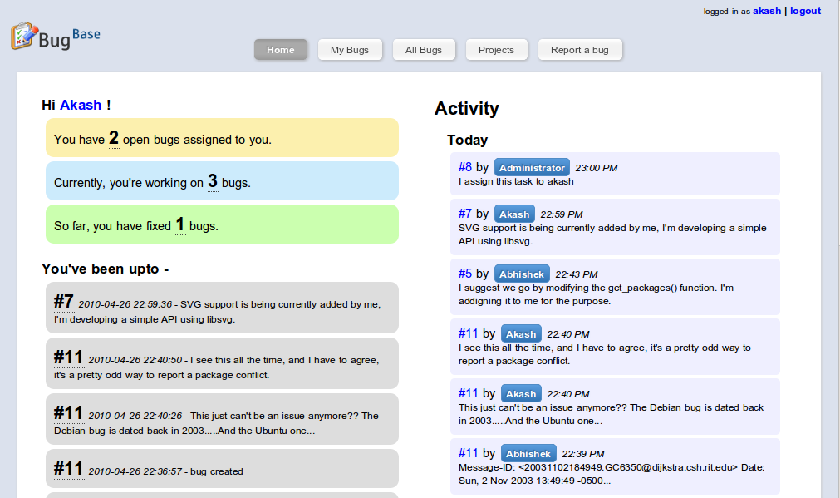
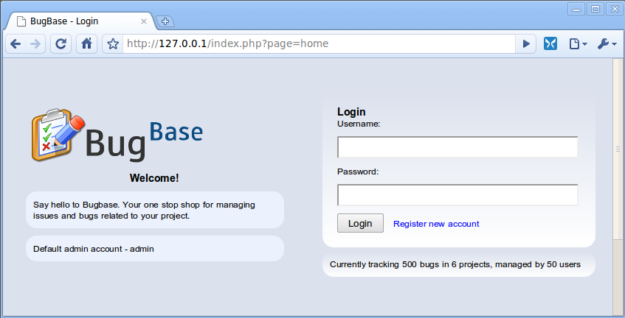
BugBase 1.0

Slide 3
Introduction

Slide 4
Introduction
Why track bugs/issues?

Slide 5
Introduction
Why track bugs/issues?
To get an idea of current state of affairs in a project

Slide 6
Introduction
Why track bugs/issues?
To get an idea of current state of affairs in a project
To share information with everyone

Slide 7
Introduction
Why track bugs/issues?
To get an idea of current state of affairs in a project
To share information with everyone
To make a newcomer’s life easier

Slide 8
Introduction
Why track bugs/issues?
To get an idea of current state of affairs in a project
To share information with everyone
To make a newcomer’s life easier
You’ve grown old and you wish to know how did you solve problem X back then

Slide 9
Introduction
Why track bugs/issues?
To get an idea of current state of affairs in a project
To share information with everyone
To make a newcomer’s life easier
You’ve grown old and you wish to know how did you solve problem X back then
To fight boredom and monotonacity

Slide 10
Introduction
Why track bugs/issues?
To get an idea of current state of affairs in a project
To share information with everyone
To make a newcomer’s life easier
You’ve grown old and you wish to know how did you solve problem X back then
To fight boredom and monotonacity
To participate in flame wars over commits

Slide 11
Introduction
Why track bugs/issues?
To get an idea of current state of affairs in a project
To share information with everyone
To make a newcomer’s life easier
You’ve grown old and you wish to know how did you solve problem X back then
To fight boredom and monotonacity
To participate in flame wars over commits
Why not?

Slide 12
So what’s BugBase?

Slide 13
So what’s BugBase?
Yeah what the hell is this thing?

Slide 14
So what’s BugBase?
Yeah what the hell is this thing?
BugBase is a simple bug/issue tracker written in PHP that keeps you from asking the big question –
“what the hell is going on?”
Or
“Could somebody tell me what happened last night, while I was smoking pot in the other room?”

Slide 15

So what’s BugBase?
Yeah what the hell is this thing?
BugBase is a simple bug/issue tracker written in PHP that keeps you from asking the big question –
“what the hell is going on?”
Or
“Could somebody tell me what happened last night, while I was smoking pot in the other room?”
What! Is this some of all bug trackers?

Slide 16
So what’s BugBase?
Yeah what the hell is this thing?
BugBase is a simple bug/issue tracker written in PHP that keeps you from asking the big question –
“what the hell is going on?”
Or
“Could somebody tell me what happened last night, while I was smoking pot in the other room?”
Maybe!
What! Is this some of all bug trackers?

Slide 17

So what’s BugBase?
Yeah what the hell is this thing?

Slide 18
So what’s BugBase?
Yeah what the hell is this thing?
There are 2 more projects with same name.

Slide 19
So what’s BugBase?
Yeah what the hell is this thing?
There are 2 more projects with same name.
One has to do with wireless, another one is a bug tacker itself

Slide 20
So what’s BugBase?
Yeah what the hell is this thing?
There are 2 more projects with same name.
One has to do with wireless, another one is a bug tacker itself
But wtf do we care about it. Everyone knows whats more awesome and whats not.

Slide 21
Features Tour

Slide 22
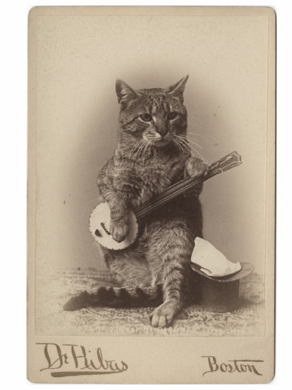
Features Tour
Demo Time!

Slide 23
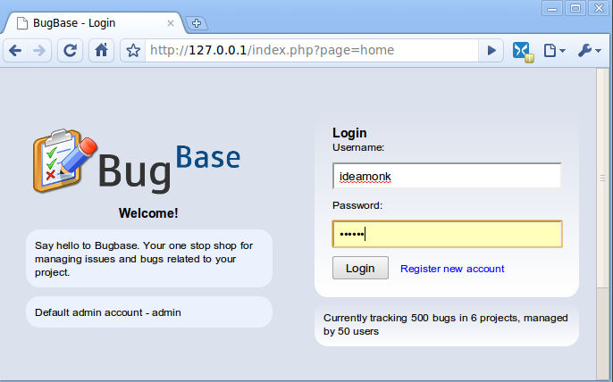
Features Tour
Login / Register

Slide 24
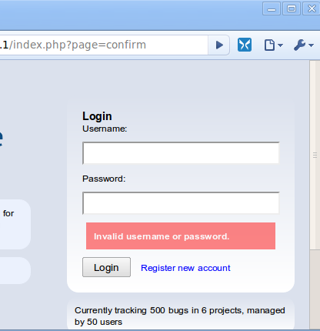
Features Tour
Login / Register

Slide 25
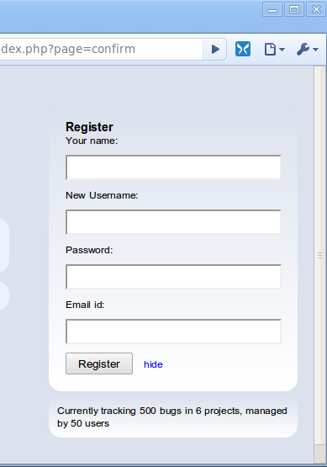
Features Tour
Login / Register

Slide 26
Features Tour
Dashboard / Home Page

Slide 27
Features Tour
Dashboard / Home Page
Getting an overview of WTF is going on

Slide 28

Features Tour
Dashboard / Home Page

Slide 29
Features Tour
Dashboard / Home Page
Your contributions quantified

Slide 30
Features Tour
Dashboard / Home Page
Your contributions quantified
Your recent work

Slide 31
Features Tour
Dashboard / Home Page
Your contributions quantified
Activity stream for today
Your recent work

Slide 32
Features Tour
Dashboard / Home Page
Your contributions quantified
Activity stream for today
Your recent work

Slide 33
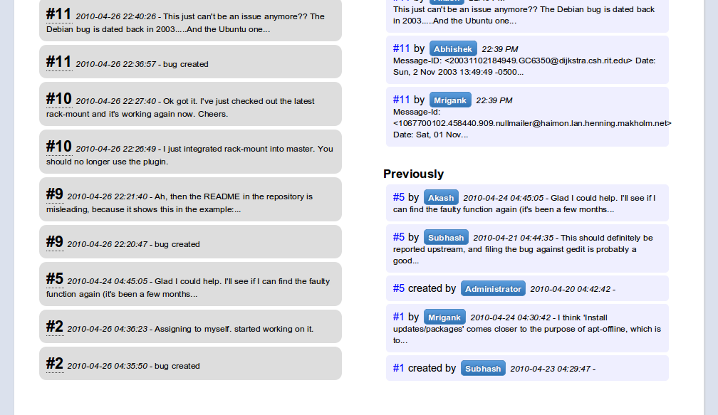
Features Tour
Dashboard / Home Page
Anything before today

Slide 34
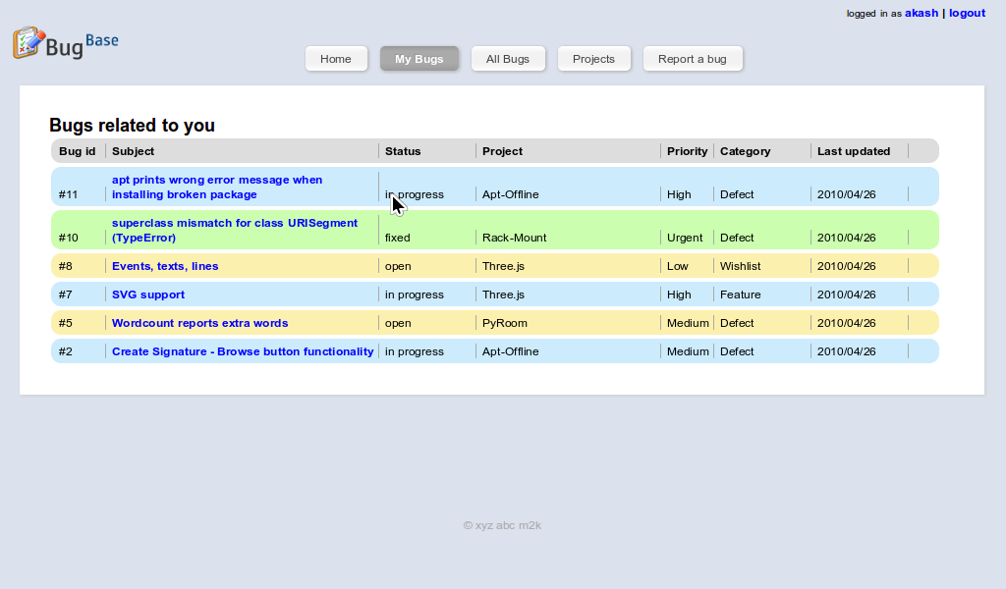
Features Tour
My Bugs Page

Slide 35
Features Tour
Login / Register

Slide 36
BugBase 1.0
What is a bug tracker?

